Slide 1


Restructuring Last Mile Delivery Network of DTDC Using Geospatial Analytics
Ignite Sales Conference 2024
- Saamira Yasmin
Senior Manager, Data Analytics
Title
Sub section

Slide 2






Customer Experience !
Undelivered shipments
due to vacant areas
Delayed deliveries and misroutes
Rise in non-serviceability with the reduction in delivery areas

Slide 3
How do we solve the end mile concerns?

Slide 4
What if we knew the exact serviceable area?

Slide 5
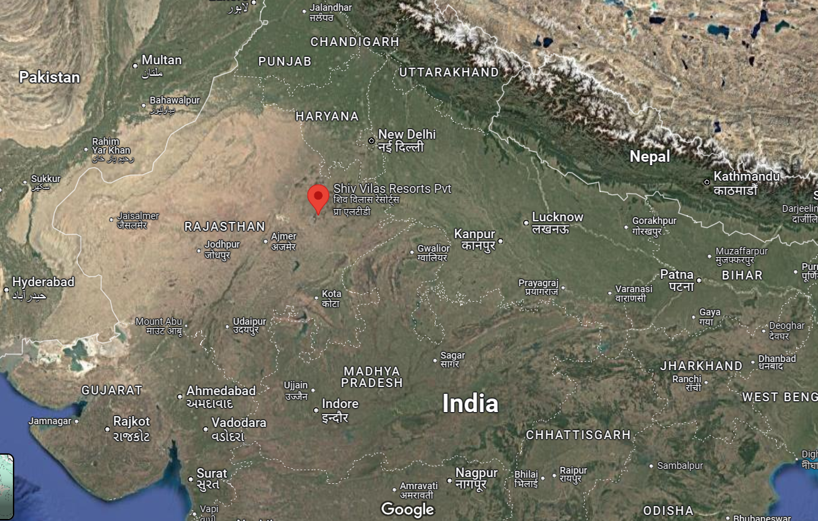

Mapping our location !
State level view
We are here !

Slide 6
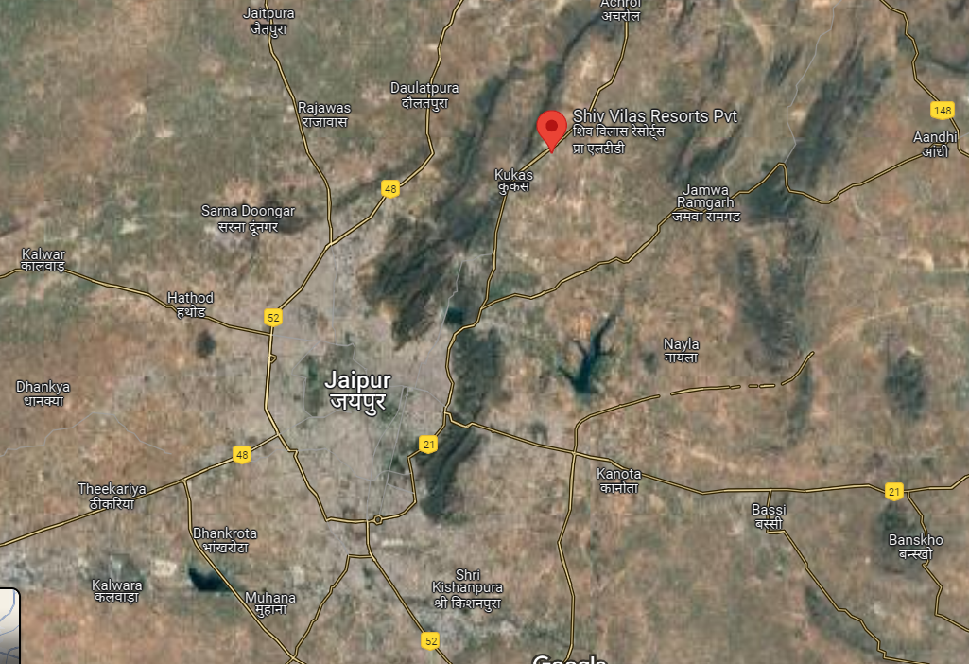

Mapping our location !
City level view
We are here !

Slide 7
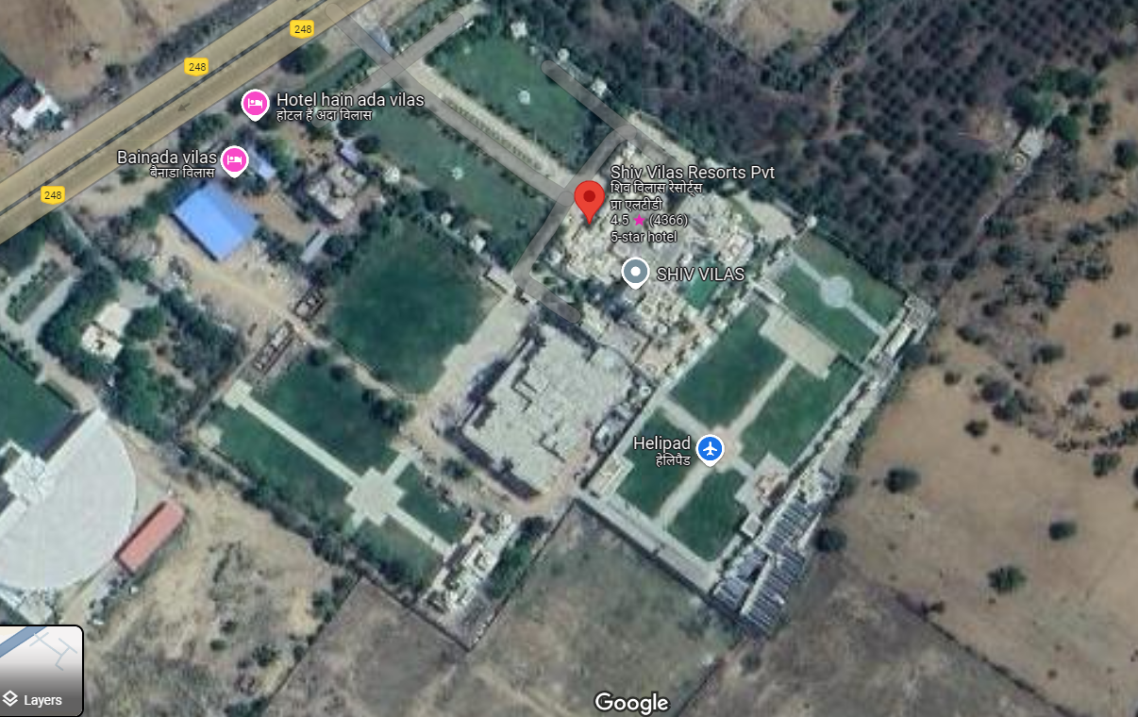

Mapping our location !
Resort Aerial view
Guess where we are in this resort?

Slide 8
What if we can exactly mark the Shiv Vilas resort area in our DTDC system?

Slide 9
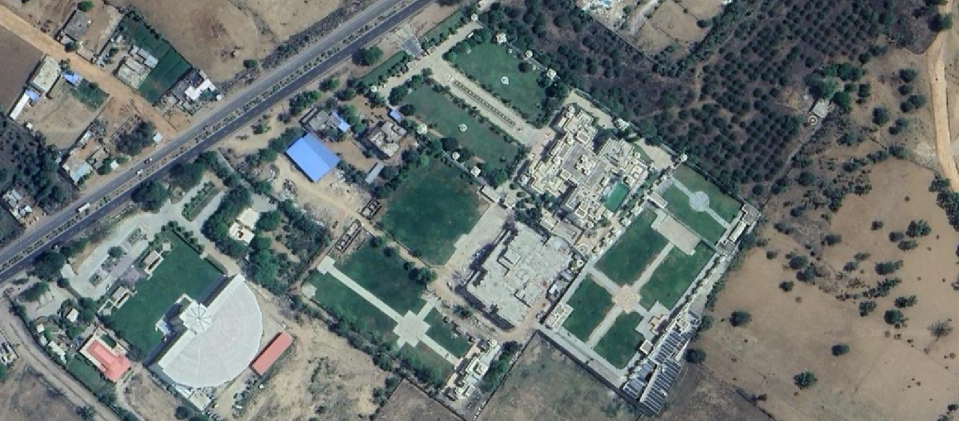
Mapping our location !
Resort Aerial view
Shiv Vilas Resort

Slide 10
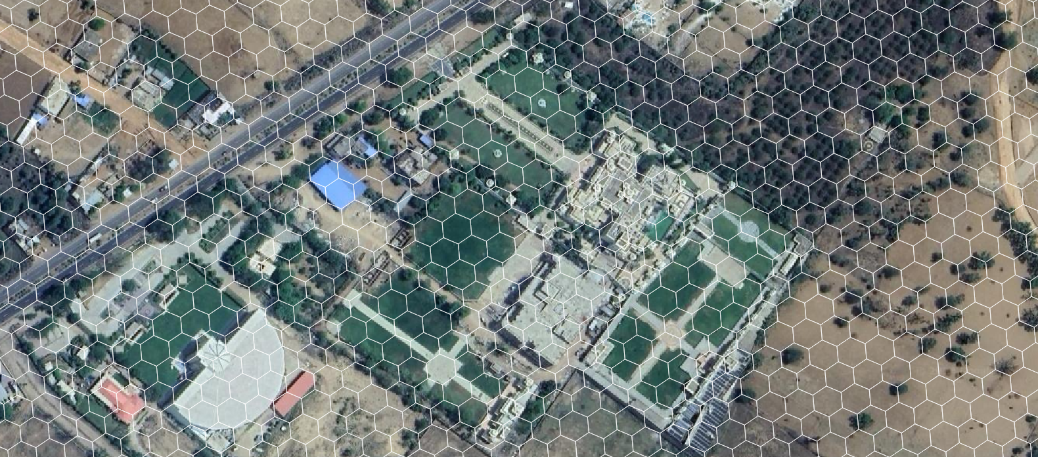
Mapping our location !
Resort Aerial view with Hexa-grid
Shiv Vilas Resort

Slide 11
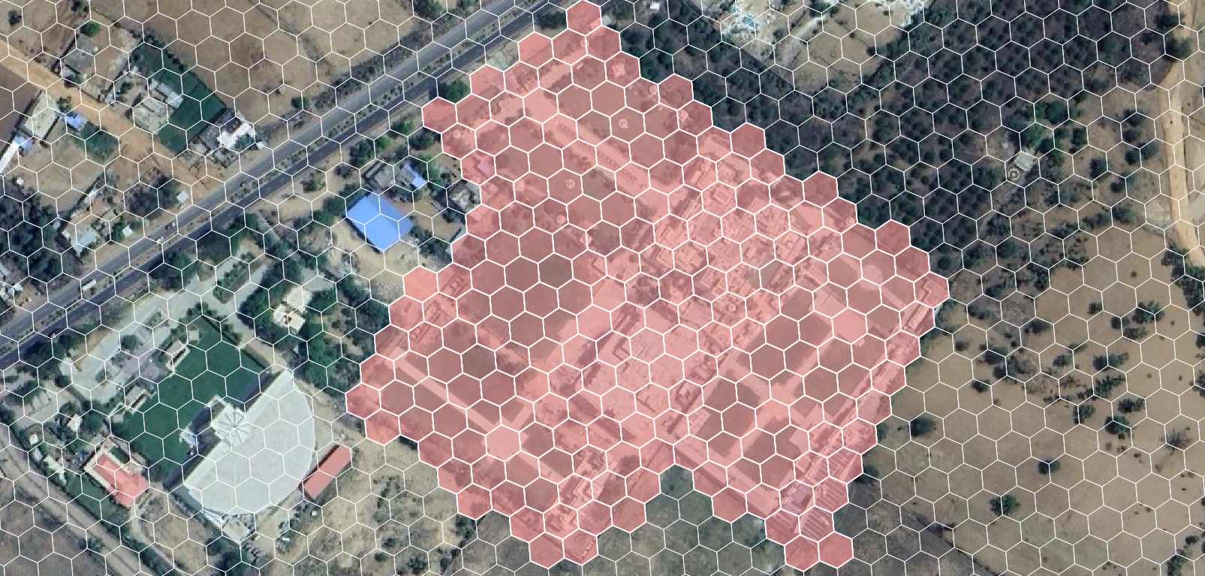
Mapping our location !
Resort Aerial view marking Shiv-Vilas area
Shiv Vilas Resort

Slide 12

Innovative approach to End Mile Planning
Dividing entire globe into tiny hexa-grid
Just 30 feet !
Salient Points
Used by leading companies globally
Unique ID for each cell
It’s Permanent !
Fast and accurate !
Mark First Mile, Last Mile, PUDO, Market Potential …

Slide 13
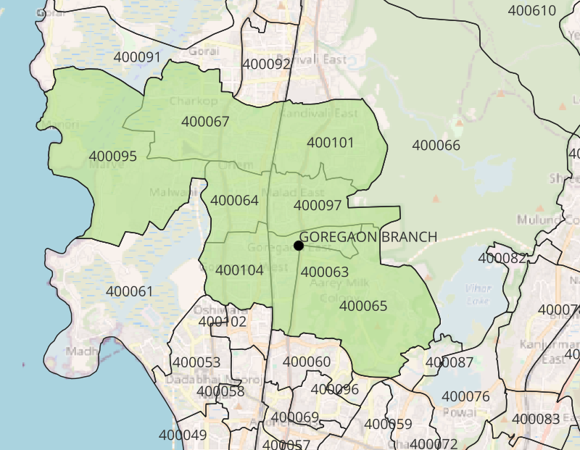
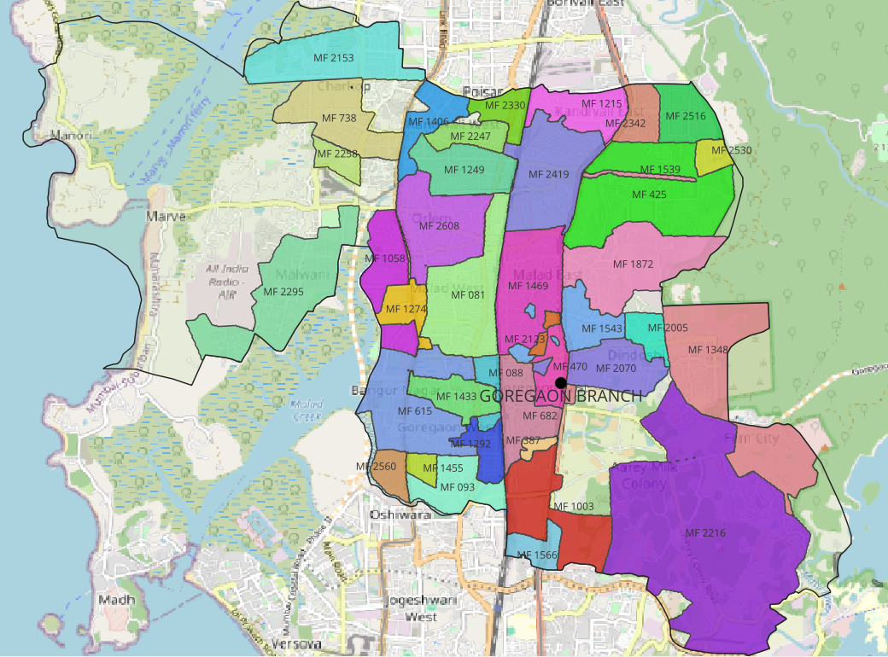

Visualising Goregaon Branch
Goregaon branch delivery pincodes area highlighted in green
CP level areas marking
Vacant areas

Slide 14
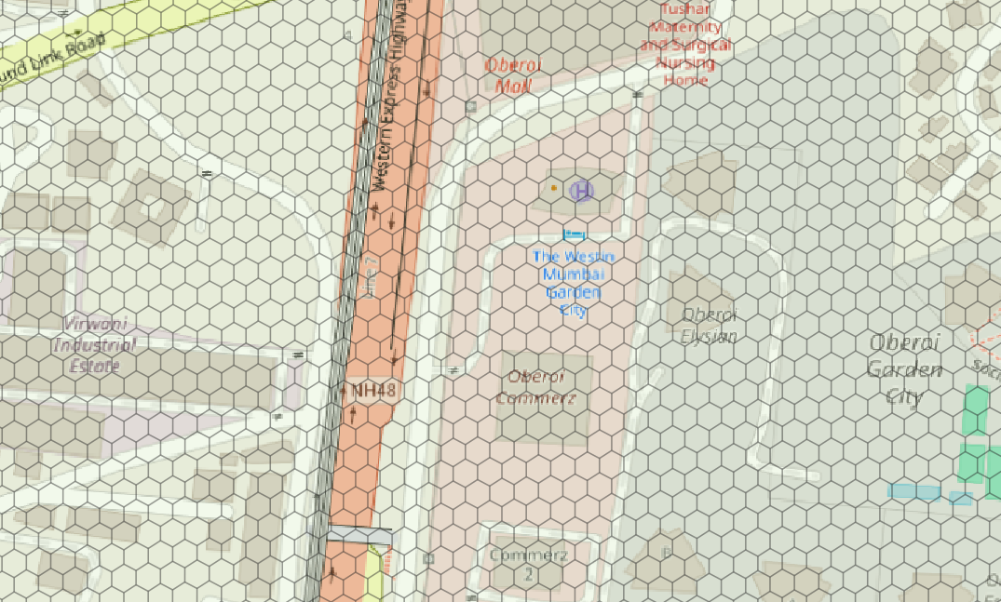
Innovative approach for End Mile Planning
Zoom-In | Example DTDC Corporate Office Area
DTDC Corporate Office
We can clearly mark each building and all roads !
We can accurately mark all our serviceable areas
No dependence on sorter and no more human errors

Slide 15
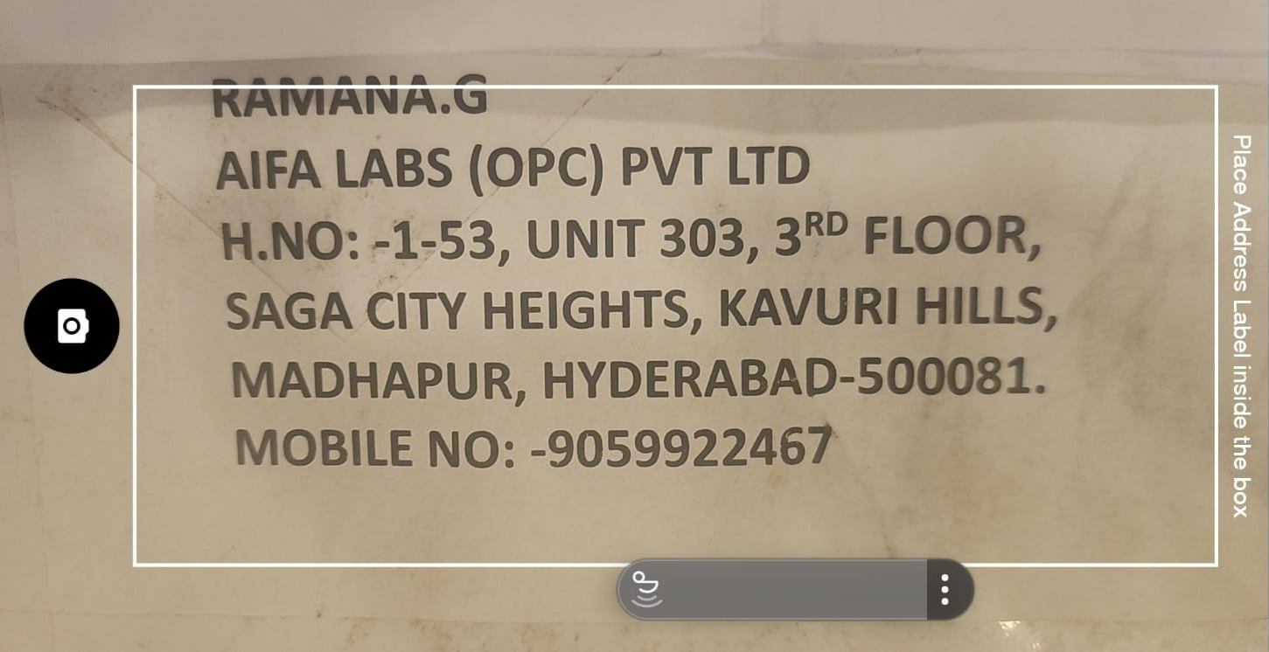
The Larger Goal (Win-Win situation)
Capture
Delivery address while booking a shipment
OCR Technology to find address
Convert to Geo-coordinate
Identify the precise delivery area (Hexa-grid mapping)
Accurate sorting and allocation to CPs
Great Customer Experience !
Accurate service mapping
Fewer misroutes
No dependency on sorters
Faster deliveries
Benefits for CPs !
Load landing profile to CPs
Easier management of resources
Hassle free delivery
Simpler allocation/ deallocation of area

Slide 16

Let’s Grow Together

